Slide 1
Metrics and Measurement
COMP6100001 - Software engineering
Session 23
Kenny Jingga, S.Kom., M.T.

Slide 2
Session 23 – Metrics and Measurement
Learning objectives
At the end of this session, students will be expected to be able to:
Explain the importance of measurement and metrics in Software Engineering
Provide examples of metrics for software qualities and process
Apply goal-based frameworks for decision making using metrics
Identify the limitations and dangers of decisions and incentives based on measurements

Slide 3
Session 23 – Metrics and Measurement
Content outline
Measurements and Metrics
How to Use Measurements and Metrics?
Risks and Challenges
Metrics and Incentives
Case Study: Autonomous Vehicle Software

Slide 4
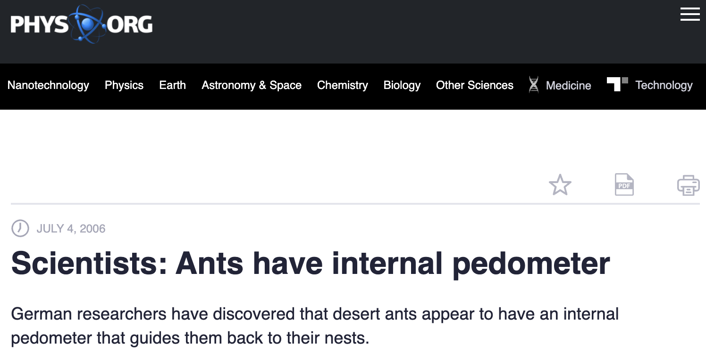
What is Measurement?
Measurement in everyday life
Economics
  Price, Inflation Rate, Stock Price, Volume
Medicine
  Heart Rate, Blood Pressure, Body Temperature, ECG
Engineering
  Force, Torque, Heat Transfer Coefficient, Thermal Efficiency
Natural Sciences
  AQI, Carbon Footprint, Soil pH

Slide 5
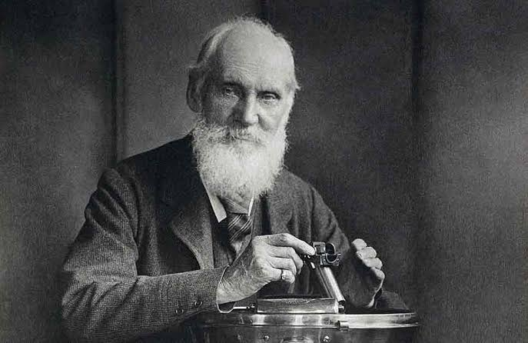

”To measure is to know; if you cannot measure it, you cannot improve it”
- William Thomson, Lord Kelvin
$$K= \frac{5(F−32)}{9}+273.15$$

Slide 6
Software Engineering: Principles, practices (technical and non-technical) for confidently building high-quality software.
What does this mean? How do we know?
Measurement and metrics are key concerns.

Slide 7
What is Measurement?
Measurement is the empirical, objective assignment of numbers, according to a rule derived from a model or theory, to attributes of objects or events with the intent of describing them. – Craner, Bond, “Software Engineering Metrics: What Do They Measure and How Do We Know?”
A quantitatively expressed reduction of uncertainty based on one or more observations. – Hubbard, “How to Measure Anything ...”

Slide 8
Software Quality Metrics
IEEE 1061 definition: “A software quality metric is a function whose inputs are software data and whose output is a single numerical value that can be interpreted as the degree to which the software possesses a given attribute that affects its quality.”
Metrics have been proposed for many quality attributes; may define own metrics
Entity
Attribute
Measurement
Object or Process
Quality of Interest
Method to obtain a number or a symbol

Slide 9
Software Quality Metrics
What entities to we care about? (Examples)
Software Product
Modules
Software Development Process
People

Slide 10
Software Quality
What Software Qualities do We Care About? (Examples)
Installability
Availability
Consistency
Portability
Regulatory Compliance
Functionality (e.g., data integrity)
Scalability
Security
Extensibility
Bugginess
Documentation
Performance

Slide 11
Process Quality
What Process Qualities do We Care About? (Examples)
Measure time, costs, actions, resources, and quality of work packages; compare with predictions
Use information from issue trackers, communication networks, team structures, etc…
Development Efficiency
Meeting Efficiency
Conformance to Processes
Reliability of Predictions
Fairness in Decision Making
Regulatory Compliance
On-time Release

Slide 12
People Quality
What People Qualities do We Care About? (Examples)
Developers
  Maintainability
  Performance
  Employee Satisfaction and Well-being
  Communication and Collaboration
  Efficiency and Flow
  Satisfaction with Engineering System
  Regulatory Compliance
Customers
  Satisfaction
  Ease of Use
  Feature Usage
  Regulatory Compliance

Slide 13
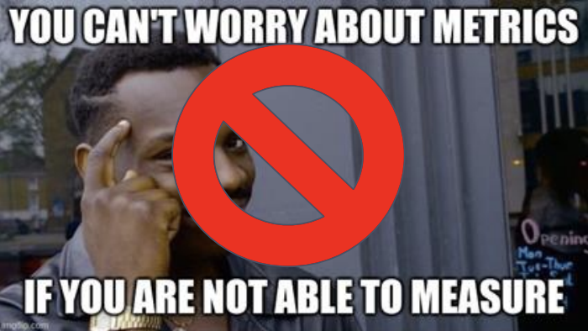
Non-Trivial Qualities
Software
  Code Elegance
  Code Maintainability
Process
  Fairness in Decision Making
Team
  Team Collaboration
  Creativity

Slide 14
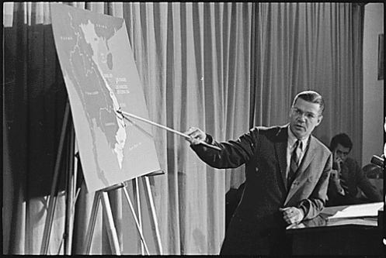

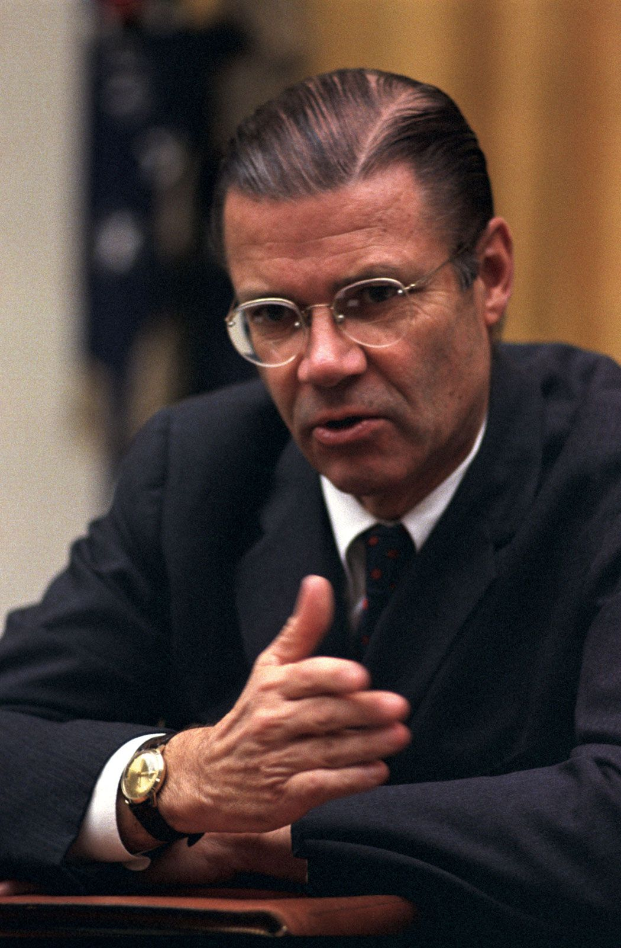

McNamara Fallacy
Measure whatever can be easily measured
Disregard that which cannot be measured easily
Presume that which cannot be measured easily is not important
Presume that which cannot be measured easily does not exist

Slide 15
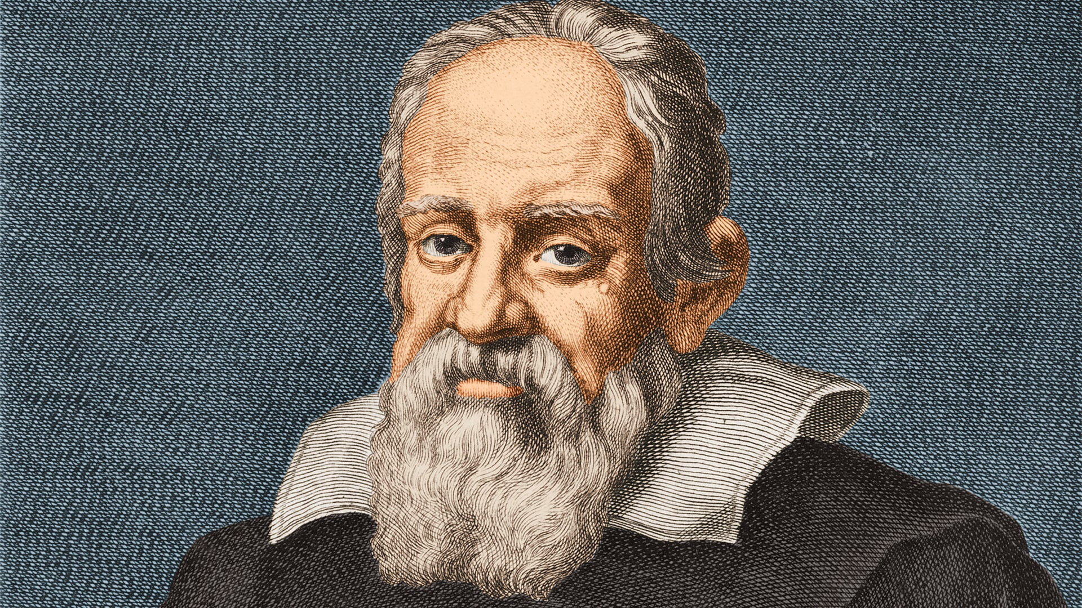
Make it Measurable
“Measure what is measurable and make measurable what is not so.”
-Galileo Galilei

Slide 16
Everything is measurable
If X is something we care about, then X, by definition, must be detectable
  How could we care about things like “quality,” “risk,” “security,” or “public image” if these things were totally undetectable, directly or indirectly?
  If we have reason to care about some unknown quantity, it is because we think it corresponds to desirable or undesirable results in some way.
If X is detectable, then it must be detectable in some amount.
  If you can observe a thing at all, you can observe more of it or less of it
If we can observe it in some amount, then it must be measurable.

Slide 17
Examples: Metrics for Source Code
Code Complexity: Lines of Code
Easy to measure
LOC | projects
450 | Expression Evaluator
2,000 | Sudoku
100,000 | Apache Maven
500,000 | Git
3,000,000 | MySQL
15,000,000 | gcc
50,000,000 | Windows 10
2,000,000,000 | Google (MonoRepo)

Slide 18
Metrics for Source Code
Halstead’s Software Science
Halstead’s Software Science: a comprehensive collection of metrics all predicated on the number (count and occurrence) of operators and operands within a component or program
Introduced by Maurice Howard Halstead in 1977
It should be noted that Halstead’s “laws” have generated substantial controversy, and many believe that the underlying theory has flaws.
However, experimental verification for selected programming languages has been performed.

Slide 19
Metrics for Source Code
Code Complexity: Halstead Volume
Halstead Volume = number of operators/operands * log₂ (number of distinct operators/operands)
Approximates size of elements and vocabulary
Example:
main() {
  int a, b, c, avg;
  scanf("%d %d %d", &a, &b, &c);
  avg = (a + b + c) / 3;
  printf("avg = %d", avg);
}
Operators/Operands: main, (), {}, int, a, b, c, avg, scanf, (), "...", &, a, &, b, &, c, avg, =, a, +, b, +, c, (), /, 3, printf, (), "...", avg

Slide 20
Metrics for Source Code
Code Complexity: Cyclomatic Complexity
Proposed by McCabe 1976
Based on control flow graph, measures linearly independent paths through a program
  ~= number of decisions
  Number of test cases needed to achieve branch coverage
  M = edges of CFG – nodes of CFG + 2*connected components
“For each module, either limit cyclomatic complexity to [X] or provide a written explanation of why the limit was exceeded.”

Slide 21
Metrics for Source Code
Code Complexity: Object-Oriented Metrics
Number of Methods per Class
Depth of the Inheritance Tree
Number of Child Classes
Coupling between Object Classes
Calls to Methods in Unrelated Classes
…

Slide 22
Metrics for Source Code
Code Complexity: “Allowable Mass” Proxy
More complex the software task ➔ consumes bigger part of the mass budget (in grams)
Keeps the software from growing unconstrained and ensuring maintainability and quality by existing staff

Slide 23
Measurement Scales
Scale: the type of data being measured
The scale dictates what sorts of analysis/arithmetic is legitimate or meaningful
Your options are:
  Nominal: categories
  Ordinal: order, but no magnitude.
  Interval: order, magnitude, but no zero.
  Ratio: Order, magnitude, and zero.
  Absolute: special case of ratio.

Slide 24
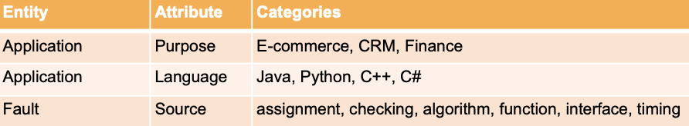
Measurement Scales
Nominal/Categorical Scale
Entities classified with respect to a certain attribute. Categories are jointly exhaustive and mutually exclusive.
  No implied order between categories!
Categories can be represented by labels or numbers; however, they do not represent a magnitude, arithmetic operation have no meaning.
Can be compared for identity or distinction, and measurements can be obtained by counting the frequencies in each category. Data can also be aggregated.

Slide 25
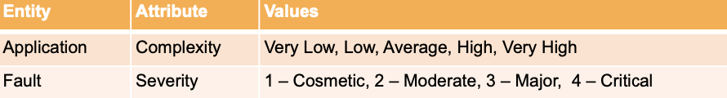
Measurement Scales
Ordinal Scale
Ordered categories: maps a measured attribute to an ordered set of values, but no information about the magnitude of the differences between elements.
Measurements can be represented by labels or numbers, BUT: if numbers are used, they do not represent a magnitude.
  Honestly, try not to do that. It eliminates temptation.
You cannot: add, subtract, perform averages, etc (arithmetic operations are out).
You can: compare with operators (like “less than” or “greater than”), create ranks for the purposes of rank correlations (Spearman’s coefficient, Kendall’s τ).

Slide 26
Measurement Scales
Interval Scale
Has order (like ordinal scale) and magnitude.
  The intervals between two consecutive integers represent equal amounts of the attribute being measured.
Does NOT have a zero: 0 is an arbitrary point, and doesn’t correspond to the absence of a quantity.
Most arithmetic (addition, subtraction) is OK, as are mean and dispersion measurements, as are Pearson correlations. Ratios are not meaningful.
  Ex: The temperature yesterday was 32 C, and today is 16 C. Was it twice as warm yesterday?
Incremental variables (quantity as of today – quantity at an earlier time) and preferences are commonly measured in interval scales.

Slide 27
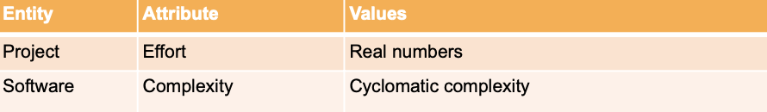
Measurement Scales
Ratio Scale
An interval scale that has a true zero that actually represents the absence of the quantity being measured.
All arithmetic is meaningful.
Absolute scale is a special case, measurement simply made by counting the number of elements in the object.
  Takes the form “number of occurrences of X in the entity.”

Slide 28
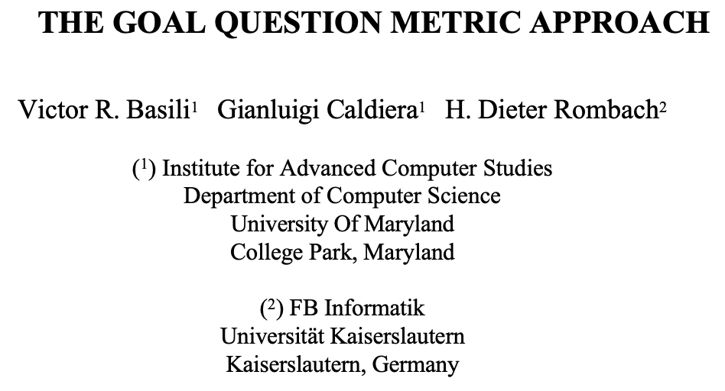
How to use Measurements and Metrics?
A Goal-based Framework
“Every measurement action must be motivated by a particular goal or need that is clearly defined and easily understandable.”
Software Metrics: A Rigorous and Practical Approach. N.Fenton, J.Bieman
Goal: What do you want to achieve?
Questions: What do you need to answer to know whether your goal is met?
Metrics: What measurements do you need in order to answer each question?

Slide 29
Goal Questions Metrics (GQM)
Defining Goals
P: Purpose (improve, evaluate, monitor, …)
I: Issue (reliability, usability, effectiveness, …)
O: Object (final product, component, process, activity)
V: Viewpoint (any stakeholder)

Slide 30
Goal Questions Metrics (GQM)
Examples (1)
Evaluate the effectiveness of the organization’s coding standard from the team’s perspective
Goal:
Questions:
Metrics:
How comprehensible are the coding standards?
What is the impact of coding standards on the efficiency and productivity of the team?
Survey results measuring team members’ understanding
Number of revisions required to achieve standard compliance
Code size: LOC, number of classes, number of functions

Slide 31
Goal Questions Metrics (GQM)
Examples (2)
Monitor the performance of the web server to enable the ops team to make decisions
Goal:
Questions:
Metrics:
How quickly can users complete their tasks?
How many concurrent users can we support?
Average latency per request in milliseconds
Throughput: Number of requests served per second
Peak memory consumption, as a % of max available

Slide 32
Measurement for decision making
Fund project?
More testing?
Fast enough? Secure enough?
Code quality sufficient?
Which feature to focus on?
Developer bonus?
Time and cost estimation? Predictions reliable?

Slide 33
Why Should we measure engineering productivity?
To increase the scope of business without commensurate increase in communication overhead → increase the productivity of individual engineers in the organization
Is it even worth measuring?
  Measurement is expensive: it takes people to measure the process, analyze the results, and disseminate them to the rest of the company
  Furthermore, the measurement process itself might be onerous and slow down the rest of the engineering organization
  Need to measure and estimate smartly
Successful at measuring software process means giving a stakeholder the data they need to make a decision

Slide 34
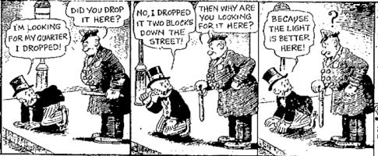
Risk and Challenges
Measurement is difficult
The streetlight effect
A known observational bias.
People tend to look for something only where it’s easiest to do so.
  If you drop your keys at night, you’ll tend to look for it under streetlights.

Slide 35
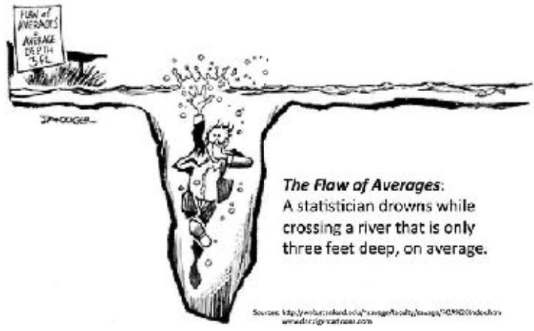
Risk and challenges
What Could Possibly Go Wrong?
Bad statistics: A basic misunderstanding of measurement theory and what is being measured.
Bad decisions: The incorrect use of measurement data, leading to unintended side effects.
Bad incentives: Disregard for the human factors, or how the cultural change of taking measurements will affect people.

Slide 36
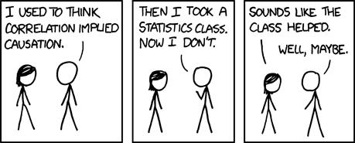
Risk and challenges
Making inferences
To infer causation:
  Provide a theory (from domain knowledge, independent of data)
  Show correlation
  Demonstrate ability to predict new cases (replicate/validate)

Slide 37
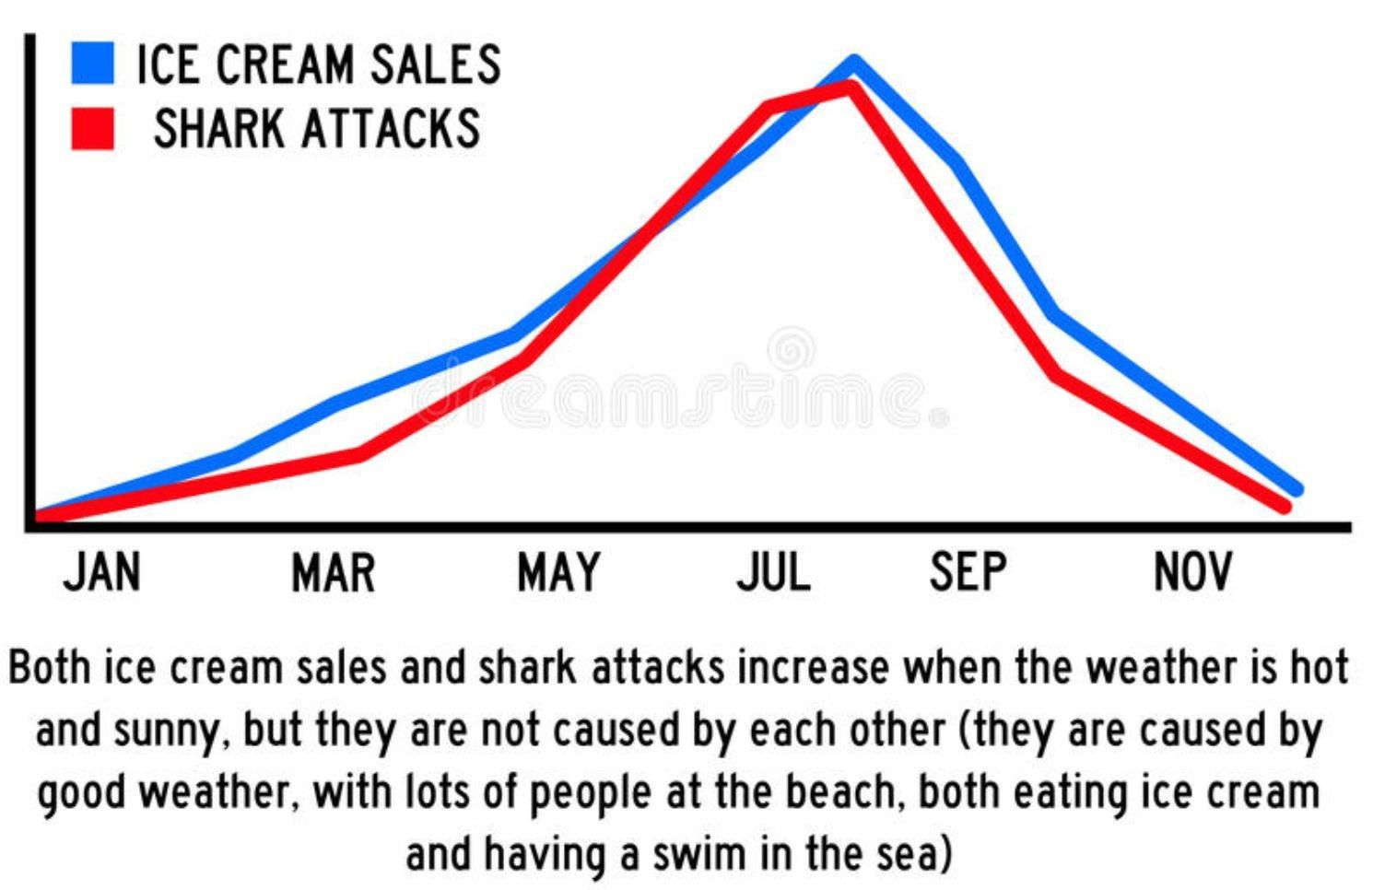
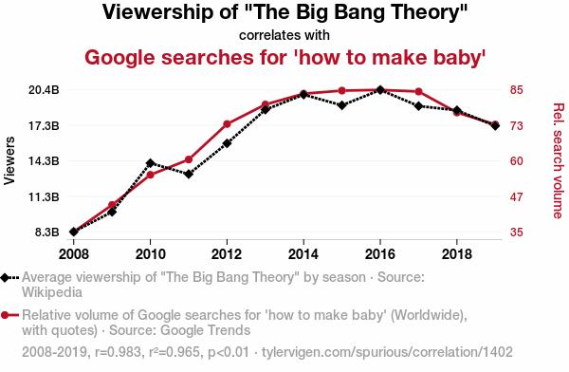
Risk and challenges
Spurious Correlations

Slide 38
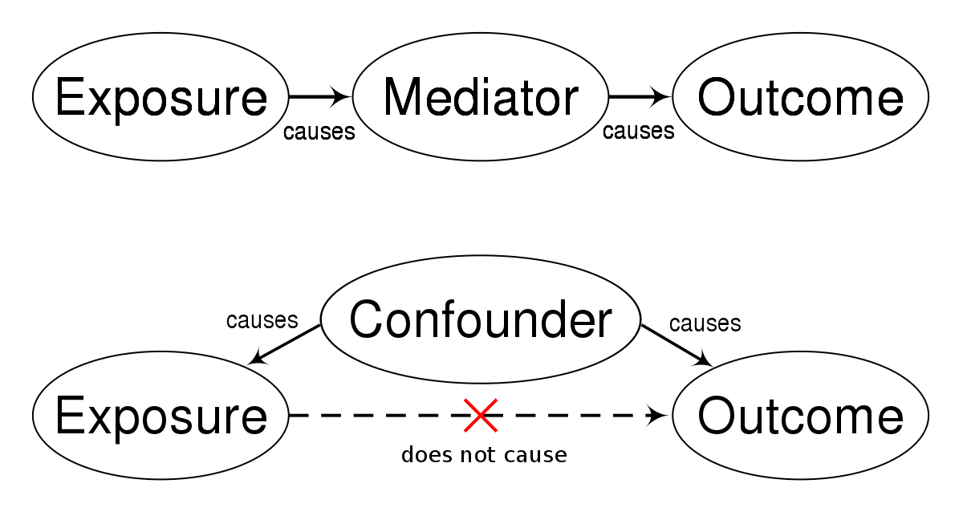
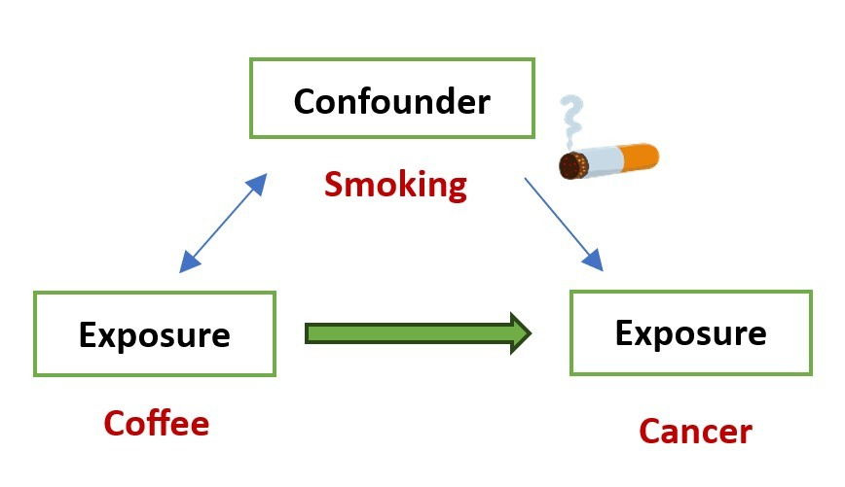
Risk and challenges
Spurious Correlations: Confounding variables
If you look only at the coffee consumption → cancer relationship, you can get very misleading results
Smoking is a confounder

Slide 39
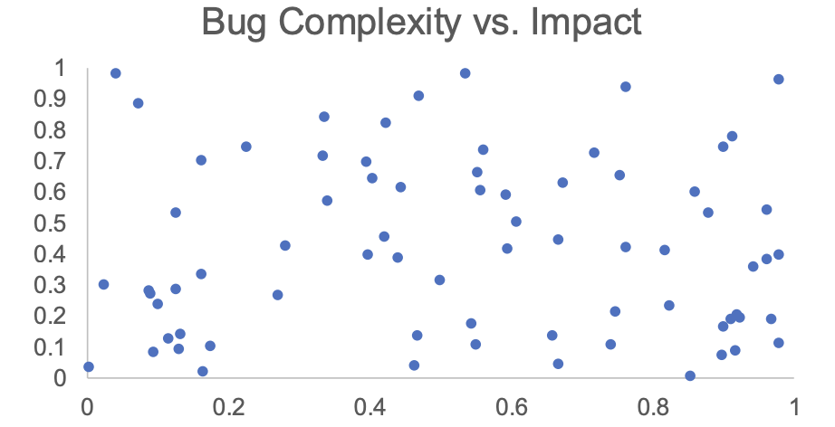
Risk and challenges
Spurious Correlations: Berkson’s Paradox

Slide 40
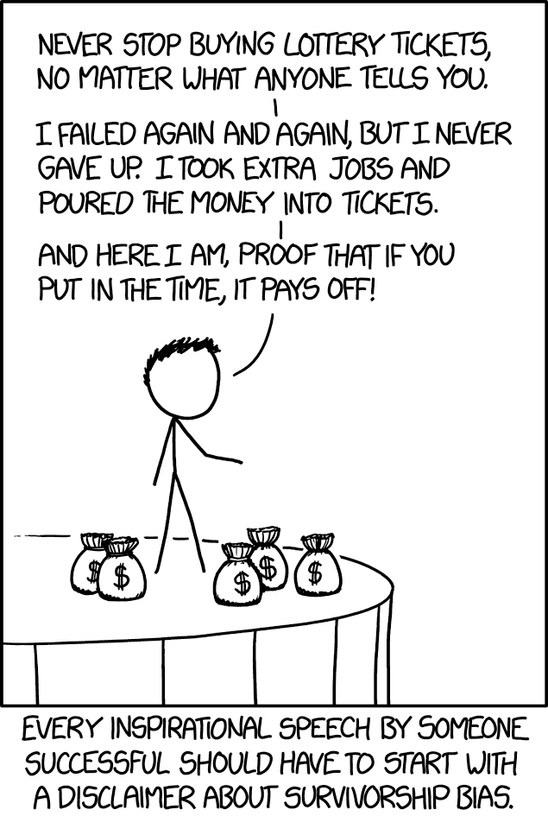
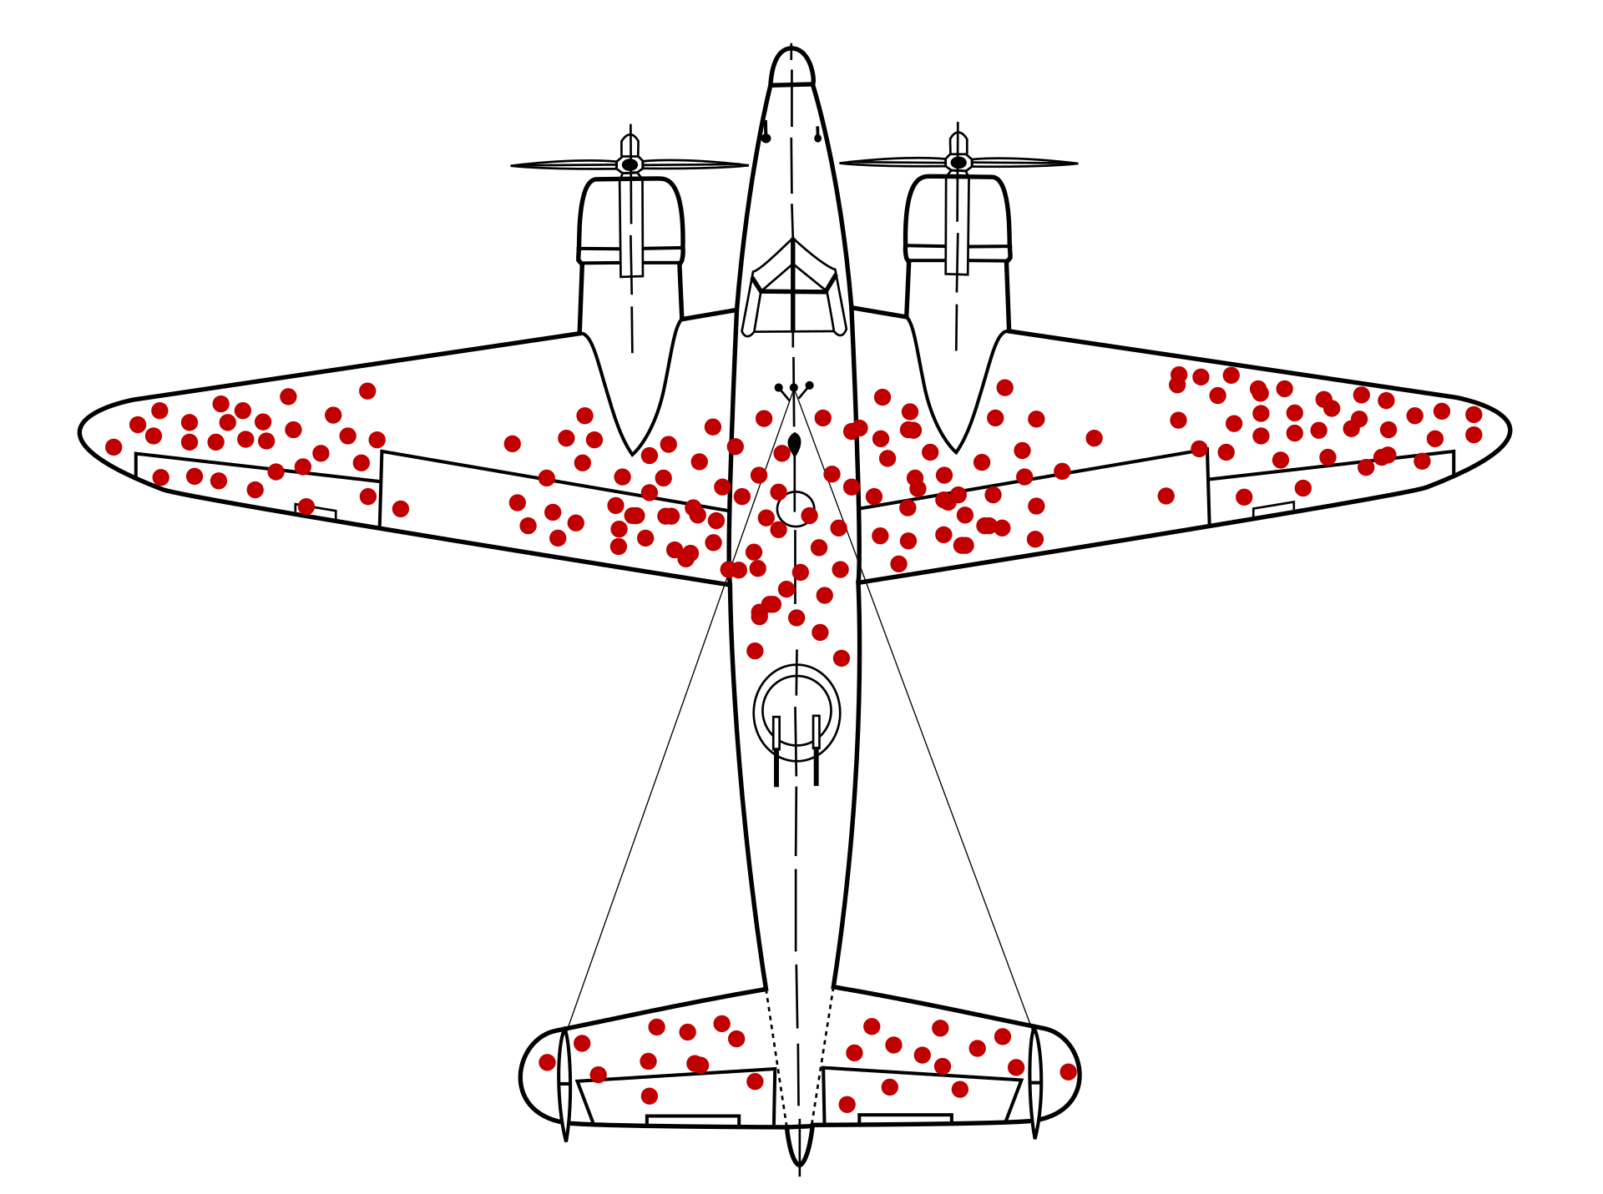
Risk and challenges
Survivorship bias
Notes:
A popular visual representation of survivorship bias. This diagram shows where returning WW2-era planes were hit. Suggesting that the red clusters should be reinforced exemplifies survivorship bias, as only the planes that didn't crash were analyzed.

Slide 41
Risk and Challenges
Measurement reliability
Extent to which a measurement yields similar results when applied multiple times
Goal is to reduce uncertainty, increase consistency
Example: Performance
  Time, memory usage
  Cache misses, I/O operations, instruction execution count, etc.
Law of large numbers
  Taking multiple measurements to reduce error
  Trade-off with cost

Slide 42
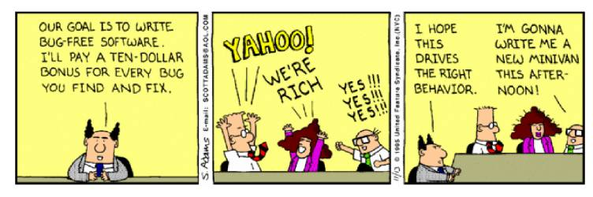
Metrics and incentives
Goodhart’s law: “When a measure becomes a target, it ceases to be a good measure.”
Notes:
https://www.learnsignal.com/blog/wells-fargo-fake-accounts-scandal-overview-2/

Slide 43
Metrics and incentives
Incentivizing productivity
What happens when developer bonuses are based on
  Lines of code per day?
  Amount of documentation written?
  Low number of reported bugs in their code?
  Low number of open bugs in their code?
  High number of fixed bugs?
  Accuracy of time estimates?

Slide 44

Case Study: Autonomous Vehicle Software
By What Metrics can we judge AV software (e.g., Safety)

Slide 45
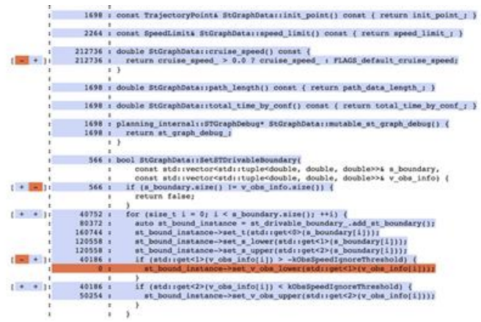
Case Study: Autonomous Vehicle Software
(1) Code coverage
Amount of code executed during testing
Statement coverage, line coverage, branch coverage, etc.
E.g., 75% branch coverage / ¾ if-else outcomes have been executed

Slide 46
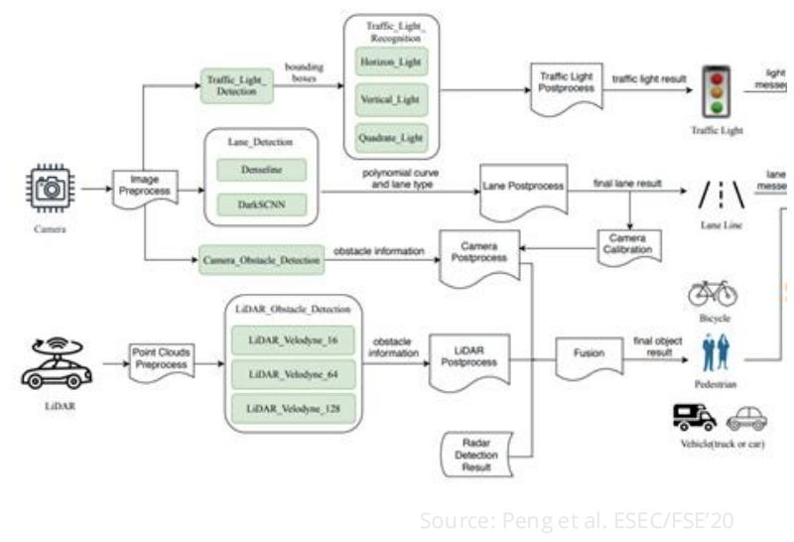
Case Study: Autonomous Vehicle Software
(2) Model accuracy
Train machine-learning models on labelled data (sensor data + ground truth)
Compute accuracy on a separate labelled test set
E.g., 90% accuracy implies that object recognition is right for 90% of the test inputs

Slide 47
Case Study: Autonomous Vehicle Software
(3) Failure Rate
Frequency of crashes / fatalities
Per 1,000 rides, per million miles, per month (in the news)

Slide 48
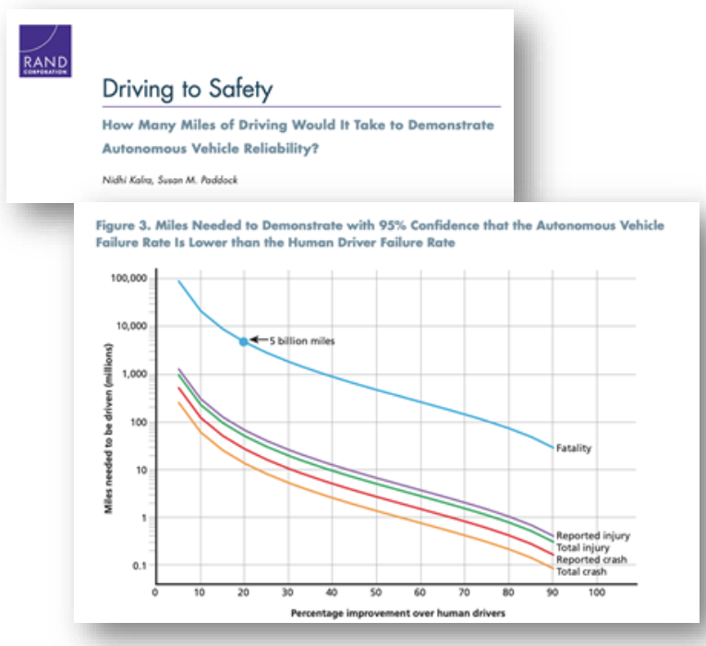
Case Study: Autonomous Vehicle Software
(4) Mileage

Slide 49
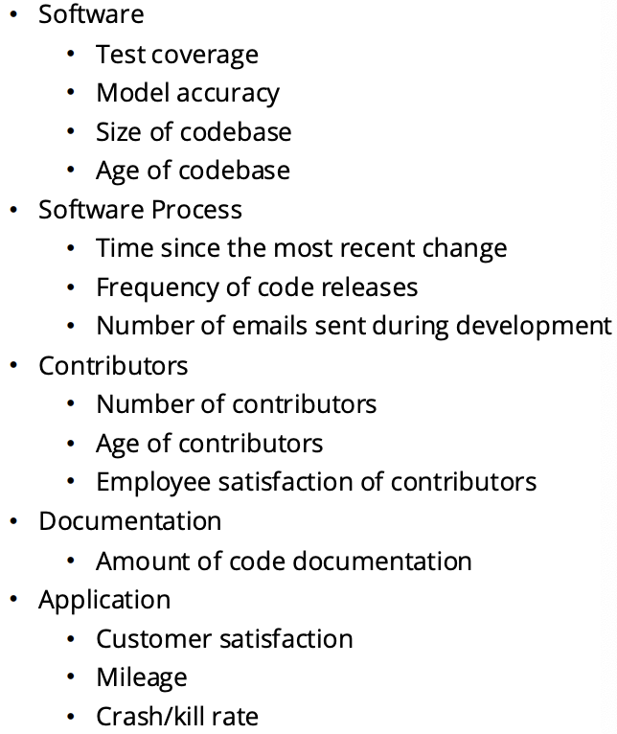
Case Study: Autonomous Vehicle Software
Activity
Work in groups
Apply the Goal-Question-Metric framework to explore various aspects of AV software
Define one goal, two questions, and at least one metric per question

Slide 50
References
Titus Winters, Tom Manshreck, and Hyrum Wright. (2020). Software Engineering at Google: Lesson Learned from Programming Over Time. 1st. O’Reilly Media. California. ISBN: 978-1492082798.
Roger Pressman and Bruce Maxim. (2020). Software Engineering: A Practitioner's Approach. 9th E. McGraw- Hill. New York. ISBN: 9781259872976.

